Slide 1

Heart Disease Diagnostic Analysis
A VENKAT RAMANA

Slide 2
OBJECTIVE :
Health is real wealth in the pandemic time we all realized the brute effects of covid-19 on all irrespective of any status. You are required to analyze this health and medical data for better future preparation.

Slide 3
PROBLEM STATEMENT
Develop a report by extracting –transforming –loading of data which contains information such as Heart disease rates, Heart disease by gender, by age. and find some relationship through data to understand and analyze the facts. Make the necessary dashboard with the best you can extract from the data.

Slide 4
Attribute Information :
● age: The person's age in years
● sex: The person's sex (1 = male, 0 = female)
● cp: The chest pain experienced (Value 1: typical angina, Value 2: atypical angina, Value 3: non-anginal pain, Value 4: asymptomatic)
● trestbps: The person's resting blood pressure (mm Hg on admission to the hospital)
● chol: The person's cholesterol measurement in mg/dl
● fbs: The person's fasting blood sugar (> 120 mg/dl, 1 = true; 0 = false)

Slide 5
Attribute Information :
● restecg: Resting electrocardiographic measurement (0 = normal, 1 = having ST-T wave abnormality, 2 = showing probable or definite left ventricular hypertrophy by Estes' criteria)
● exang: Exercise induced angina (1 = yes; 0 = no)
● oldpeak: ST depression induced by exercise relative to rest
● slope: the slope of the peak exercise ST segment (Value 1: upsloping, Value 2: flat, Value 3: downs loping)
● ca: The number of major vessels (0-3)

Slide 6
Attribute Information :
● thal: A blood disorder called thalassemia (3 = normal; 6 = fixed defect; 7 = reversable defect) ● target: Heart disease (0 = no, 1 = yes

Slide 7
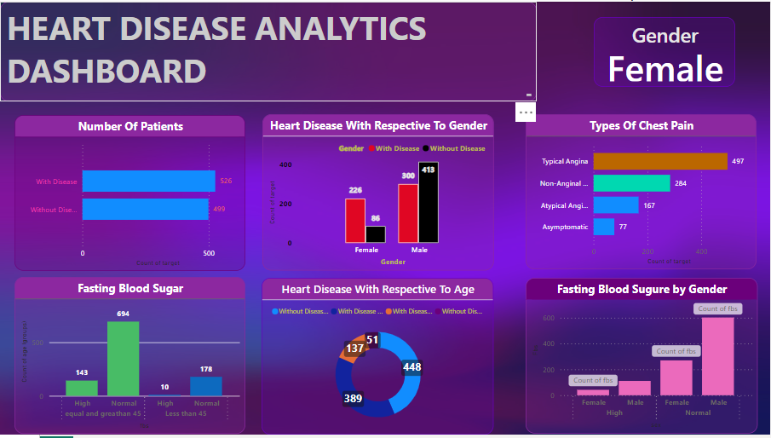
DASHBOARD:

Slide 8

THANK YOU
A VENKAT RAMANA

